Slide 1
What is it?
Determining the object of description

Slide 2
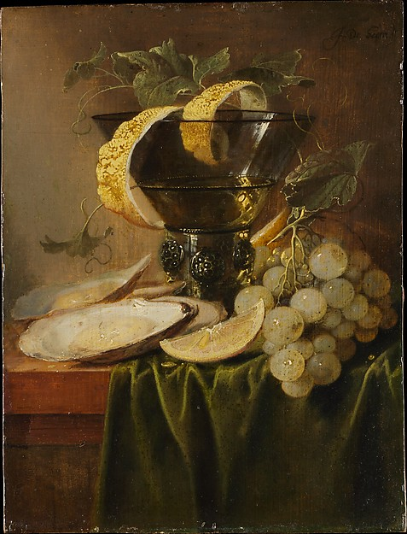
What is it?
Notes:
this is not a rhetorical question, I’m asking you! What is it? Yell out some answers. Don’t worry, you won’t be wrong!

Slide 3
What is it?
Is it
Art?
A painting?
An image?
An information resource?
A JPEG?
A digital file?
A still life?
An Dutch painting?
“Still life with oysters and lemon” by Jan Davisdz de Heem, circa 1640?
“Still life with oysters and a glass” by Jan Davidsz de Heem, circa 1640?
A representation of “Still life with oysters and lemon”?
A high-quality digitization?
Something that haunts me?

Slide 4
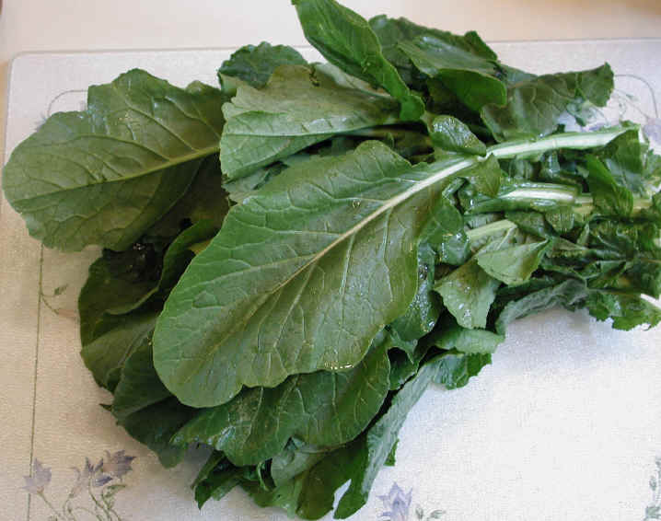
What is it?
Notes:
When we think about the array of salient identities that we might assign to any particular “thing,” we can establish that some of these identities represent different perspectives or dimensions of interest. Being a plant is just a matter of organism, not of anything to do with human activity, such as eating. Weeds have to do with distinctions between gardening intentions and intrusions. Vitamins are to do with nutrition, crops with agriculture and economics, ingredients with cooking, regional specialties with history and culture, dinner with activities and lifestyles (for some people, a vegetable can never be dinner, while for other people, dinner is typically focused on vegetables).
Other of these identities represent different levels of abstraction for a single dimension. Turnip greens are a kind of plant; a vegetable is a kind of crop, or a kind of food. One of our tasks in describing something is to determine the level of abstraction of our interest. If you are shopping for a saute pan, you want to know the dimensions of a particular model of All Clad pan, not the dimensions of a particular pan at Williams-Sonoma in the Reston Town Center down the road here. However, sometimes you also want to track the location of that particular pan. A single physical thing may be described as multiple entities in a database, with each entity showing that thing in a different role, or expressing a different facet of our interest in that thing.

Slide 5
What is it?
Is it
A plant?
A vegetable?
A weed?
Turnip greens?
A good source of Vitamin A?
A good source of antioxidants?
Food?
Dinner?
An ingredient?
A crop?
A regional specialty of the Southern United States?
A photograph?
Photograph #ZK32150 in a collection somewhere?

Slide 6
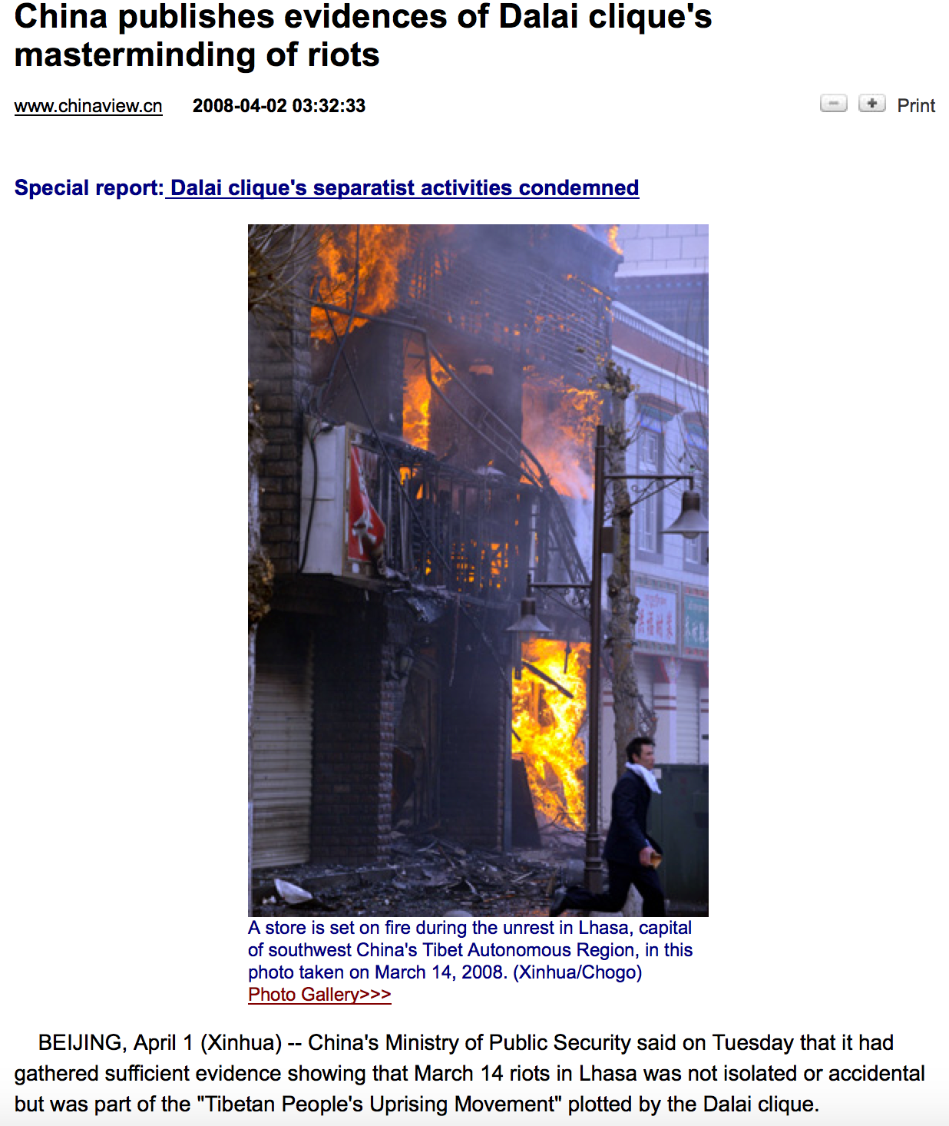
What is it?

Slide 7
What is it?
Is it:
An event?
A riot?
A protest?
A terrorist attack?
An armed conflict?
A report about a terrorist attack?
An official report from the Chinese news agency Xinhua?
Propaganda?
One version of an event report?

Slide 8
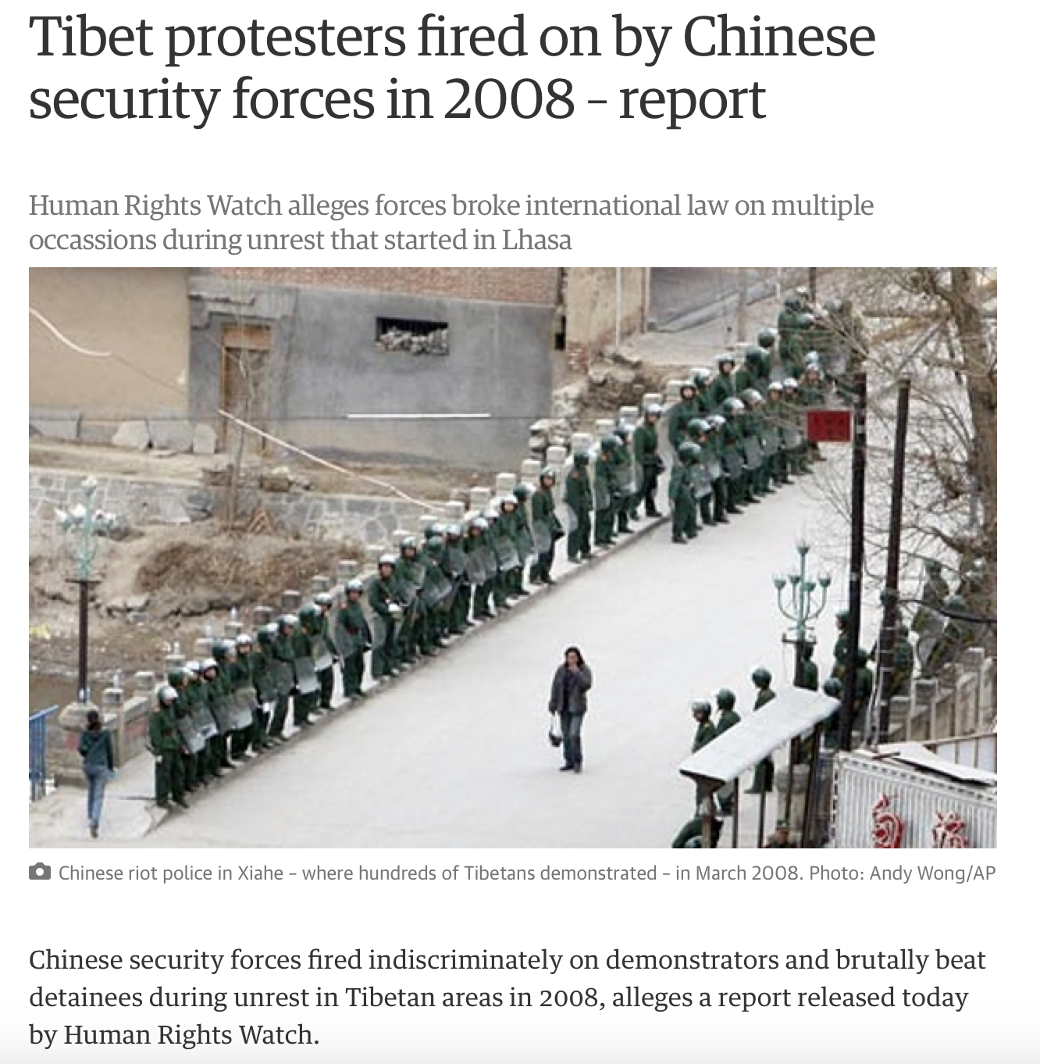
What is it?
Notes:
read the text on the screen

Slide 9
What is it?
Is it:
A demonstration?
Civil unrest?
Protest followed by riots followed by unrest?
A report about a demonstration?
A report by the Guardian about a report from Human Rights Watch?

Slide 10
Information entities
Information entities are usually (although not always) of interest for their contents (or what they represent) as opposed to their physical characteristics.
When we talk about information entities, we are usually speaking about their contents at some level of abstraction.

Slide 11
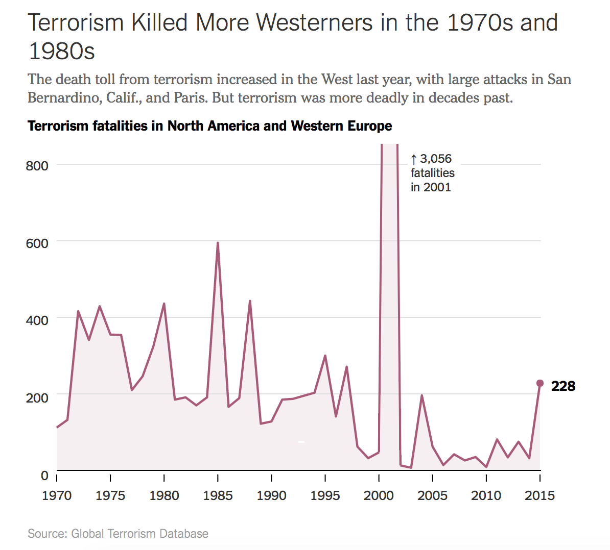
Is terrorism increasing?
Margot Sanger-Katz, “Is Terrorism Getting Worse? In the West, Yes. In the World, No.” New York Times August 16, 2016

Slide 12
What is it?
Yes!
The salient identity of any particular “thing” is to some degree arbitrary and therefore uncertain.
The salient identity both determines and is defined by a context.

Slide 13
What is it?
No!
That image is not art! Turnip greens are not dinner! There is no such thing as a “vegetable” in botany! That painting is a forgery! The Tibetan protests were not terrorism!
Ambiguity, instability, and disagreement are inherent in any classificatory activity—and inherent in metadata.

Slide 14
What is it?
Who cares?! Just describe whatever it is already.
If we are imprecise about what we are describing, we may have problems finding, accessing, and using data.
For example, if we use the same identifier to describe different resources (say, the same metadata record has information about a painting and about a digitized image of the painting), then we we don’t know what metadata applies to what thing.

Slide 15
What is it?
Can a painting have multiple creation dates? Is this a mistake?
This might happen if the same identifier refers to the painting and its digitized images.

Slide 16
Summary
Determining what a thing “is” clarifies our interest in it.
Ambiguity in determining identity leads to ambiguity of description.
Information objects have many versions that can be described at various levels of abstraction.
Semantic diversity and conflict is endemic to the descriptive enterprise.

Slide 17
What is it?
We are not modeling reality, but the way information about reality is processed, by people.
—William Kent

